Slide 1

Team DJJX
Jordan Pflum
Jason Petri
Dylan Nikol
Xuxian Chen

Slide 2
Presentation Overview
01
02
03
04
Recap Previous Week
New Explanatory Variables
Universe Creation, Explanatory Variables
Additional Explanatory Variables and Reasoning Behind Them
Modeling
Bankruptcy Indicator
Logistic Regression Performance and how to deal with unbalanced dataset
Explore refining Bankruptcy Indicator

Slide 3
Previous Week Recap - Universe Creation
01
CRSP/COMPUSTAT Merged (Quarterly)
CRSP (Monthly & Daily)
SP500 (Monthly)
Data Sets
02
Exclude SIC 6000-6999
Include EXCHCD 11-20
Include SHRCD 10 | 11
Include SHRCLS ‘A’ or NaN
Exclude RET < -50
Filtering
03
Lag all accounting data by 2 months
Manipulation

Slide 4
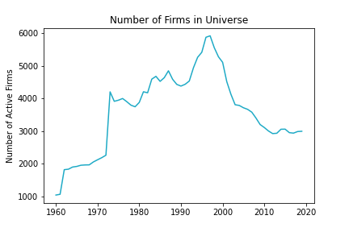
Previous Week Recap - Universe Creation

Slide 5
Previous Week Recap - Explanatory Variables
Variable | Code | Type
Net Income per Adjusted Total Assets | NITA | Fundamental
Net Income per Enterprise Value | NIMTA | Fundamental
Total Liabilities per Adjusted Total Assets | TLTA | Fundamental
Total Liabilities Per Enterprise Value | TLMTA | Fundamental
Excess Returns | EXRET | Fundamental
Relative Size | RSIZE | Fundamental
Standard Deviation of Returns | SIGMA | Fundamental
Cash Per Enterprise Value | CASHMTA | Fundamental

Slide 6
New Explanatory Variables
Variable | Code | Type
Jaccard Similarity | JACCARD | Technical
Cosine Similarity | COSINE | Technical
Minimum Edit Distance | MinEditDist | Technical
Net Income per Adjusted Total Assets (3 Month Lag) | NITA_LAG_3 | Fundamental
Net Income per Enterprise Value (3 Month Lag) | NIMTA_LAG_3 | Fundamental
... | ... | ...
Cash Per Enterprise Value (3 Month Lag) | CASHMTA_LAG_3 | Fundamental

Slide 7
Variables Overview - Text Related
'COSINE'
'JACCARD_M'
'JACCARD'
'MinEditDist'
Rationale:
Qualitative similarity and stock price comovement
The Positive Similarity of Company Filings and the Cross-Section of Stock Returns
Notes:
https://www.sciencedirect.com/science/article/abs/pii/S0378426618300773
https://papers.ssrn.com/sol3/papers.cfm?abstract_id=3690461

Slide 8
Modeling - Logistic Regression (Framework)
Time Dependent
Run a logistic regression on various time periods:
1960 - 2019
1960 - 1990
1990- 2019
3
Bankruptcy Indicator Time Frame
Adjust the time frame for bankruptcy to have occurred for indicator to be positive
3 months
6 months
1 Year
2 Years
5 Years
2
All Data
Run a logistic regression on all data.
1

Slide 9
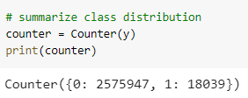
Modeling - Unbalanced Sample
class_weight
from sklearn.linear_model import LogisticRegression
The values of y to automatically adjust weights inversely proportional to class frequencies in the input data using:
n_samples / (n_classes * np.bincount(y))
SMOTE (synthetic minority oversampling technique)
from imblearn.over_sampling import SMOTE
randomly increasing minority class examples by replicating them - synthesises new minority instances between existing minority instances

Slide 10
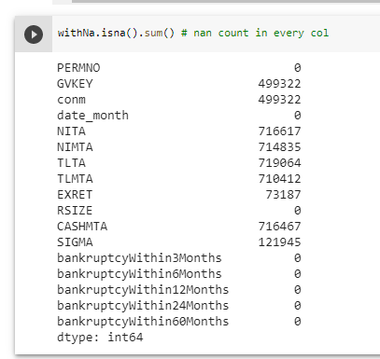
Handling NaN

Slide 11
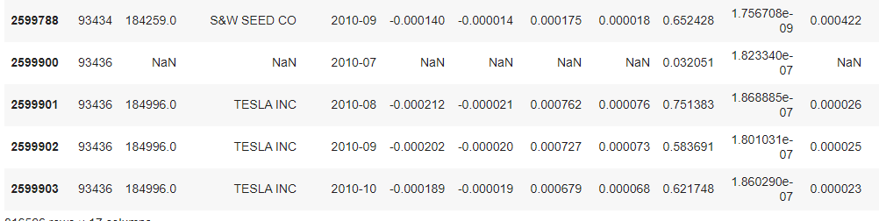
Handling NaN - Continued

Slide 12
Modeling - Logistic Regression (Results)
feature_list = ['NITA',' NIMTA', 'TLTA', 'TLMTA', 'EXRET', 'RSIZE', 'SIGMA', 'CASHMTA']
Target = bankruptcyWithin60Months
Time Frame = All fillna(‘bfill’) Train-Test split: 7:3
Across all data & whole period | Confusion Matrix On Test Set |  | Across all data & whole period | Confusion Matrix On Test Set
Class_weight | 584970 (TN) | 187835 (FP) | Class_weight + log | 554746 | 215544
 | 2310 (FN) | 3081 (TP) |  | 1609 | 3644
Specificity | Sensitivity | 75.6% | 57.15% | Specificity | Sensitivity | 20.02% | 69.37%
Across all data & whole period | Confusion Matrix On Test Set |  | Across all data & whole period | Confusion Matrix On Test Set
Class_weight + binning | 721899 | 50906 | ZTE | 769446 | 3292
 | 4879 | 512 |  | 75933 | 1392
Specificity | Sensitivity | 93.41% | 09.49% | Specificity | Sensitivity | 99.57% | 18.00%
Notes:
Sensitivity (aka Recall) means "out of all actual bankrupcies, how many did we predict as bankrupt", which can be explained as: Sensitivity (Recall) = TP / (FN + TP)
Specificity (aka Selectivity or True Negative Rate, TNR) means "out of all actual Negatives, how many did we predict as Negative", and can be written as: Specificity = TN / (TN + FP)
Accuracy = (TP + TN) / All Predictions
Mis-Classification is (1-Accuracy), and means all false predictions over the total number of predictions.
Precision (aka Positive Predictive Value, PPV) means "out of all predicted Positive cases, how many were actually Positive" Precision = TP / (TP + FP)
F1 Score is the harmonic, or weighted, an average of Precision and Sensitivity, and is a widely used measure of accuracy for classification problems. It is calculated as: F1 Score = 2 * (Precision * Sensitivity) / (Precision + Sensitivity)

Slide 13
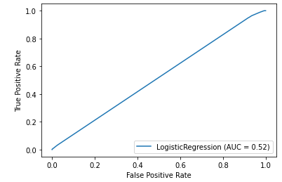
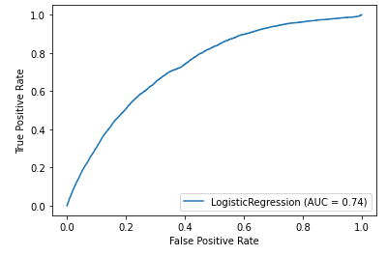
Binning data versus non-binning
Non-binning
Binning @ 5 bins
15 bins is just as bad!

Slide 14
Model Results:
'NITA', 'NIMTA', 'TLTA', 'TLMTA', 'EXRET', 'RSIZE', 'CASHMTA', 'SIGMA', 'COSINE', 'JACCARD_M', 'JACCARD', 'MinEditDist'
Time Frame | Bankruptcy Periods | Sensitivity | Specificity
All time | 3 months | 83.3% | 85.9%
All time | 6 months | 71.9% | 85.3%
All time | 12 months | 68.9% | 83.5%
All time | 24 months | 66.5% | 80.5%
All time | 60 months | 57.1% | 76.0%
Notes:
Sensitivity (Recall) = TP / (FN + TP)
# Specificity (aka Selectivity or True Negative Rate, TNR) means "out of all actual Negatives,
# how many did we predict as Negative", and can be written as:
# Specificity = TN / (TN + FP)
# Precision (aka Positive Predictive Value, PPV) means "out of all predicted Positive cases,
# how many were actually Positive", or
# Precision = TP / (TP + FP)

Slide 15
Model Results:
'NITA', 'NIMTA', 'TLTA', 'TLMTA', 'EXRET', 'RSIZE', 'CASHMTA', 'SIGMA', 'COSINE', 'JACCARD_M', 'JACCARD', 'MinEditDist'
Time Frame | Bankruptcy Periods | Sensitivity | Specificity
1960-1989 | 3 months | 90.9% | 91.1%
1960-1989 | 6 months | 73.5% | 87.1%
1960-1989 | 12 months | 69.9% | 85.7%
1960-1989 | 24 months | 70.1% | 83.1%
1960-1989 | 60 months | 63.4% | 79.1%
Notes:
Sensitivity (Recall) = TP / (FN + TP)
# Specificity (aka Selectivity or True Negative Rate, TNR) means "out of all actual Negatives,
# how many did we predict as Negative", and can be written as:
# Specificity = TN / (TN + FP)
# Precision (aka Positive Predictive Value, PPV) means "out of all predicted Positive cases,
# how many were actually Positive", or
# Precision = TP / (TP + FP)

Slide 16
Model Results:
'NITA', 'NIMTA', 'TLTA', 'TLMTA', 'EXRET', 'RSIZE', 'CASHMTA', 'SIGMA', 'COSINE', 'JACCARD_M', 'JACCARD', 'MinEditDist'
Time Frame | Bankruptcy Periods | Sensitivity | Specificity
1989 - 2019 | 3 months | 83.3% | 88.2%
1989 - 2019 | 6 months | 80.0% | 92.9%
1989 - 2019 | 12 months | 81.9% | 91.7%
1989 - 2019 | 24 months | 66.0% | 82.0%
1989 - 2019 | 60 months | 54.3% | 76.1%
Notes:
Sensitivity (Recall) = TP / (FN + TP)
# Specificity (aka Selectivity or True Negative Rate, TNR) means "out of all actual Negatives,
# how many did we predict as Negative", and can be written as:
# Specificity = TN / (TN + FP)
# Precision (aka Positive Predictive Value, PPV) means "out of all predicted Positive cases,
# how many were actually Positive", or
# Precision = TP / (TP + FP)

Slide 17
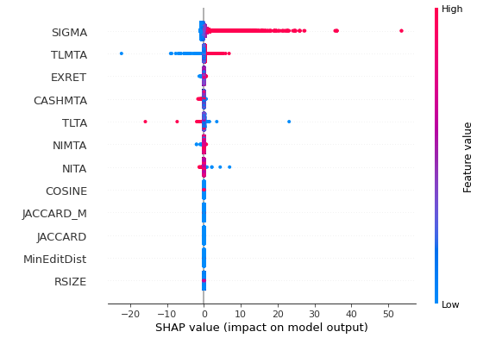
Model Sensitivity
Keep in mind, our model does not perform well.
Model Description:
60 month bankruptcy
All time history

Slide 18
Model Results:
'NITA', 'NIMTA', 'TLTA', 'TLMTA', 'EXRET', 'RSIZE', 'CASHMTA', 'SIGMA', 'COSINE', 'JACCARD_M', 'JACCARD', 'MinEditDist'
Time Frame | Bankruptcy Periods | Sensitivity | Specificity
All time | 3 months | 75.0% | 94.1%
All time | 6 months | 76.3% | 85.9%
All time | 12 months | 77.4% | 83.7%
All time | 24 months | 68.5% | 81.2%
All time | 60 months | 60.0% | 75.8%
With 1 month and 3 month lagging variables: 'NITA', 'NIMTA', 'TLTA', 'TLMTA', 'EXRET', 'RSIZE', 'CASHMTA', 'SIGMA'
Notes:
Sensitivity (Recall) = TP / (FN + TP)
# Specificity (aka Selectivity or True Negative Rate, TNR) means "out of all actual Negatives,
# how many did we predict as Negative", and can be written as:
# Specificity = TN / (TN + FP)
# Precision (aka Positive Predictive Value, PPV) means "out of all predicted Positive cases,
# how many were actually Positive", or
# Precision = TP / (TP + FP)

Slide 19
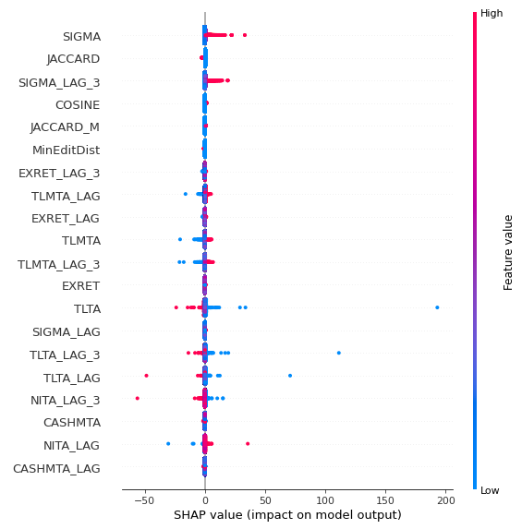
Model Sensitivity
Keep in mind, our model does not perform well.
Model Description:
60 month bankruptcy
All time history

Slide 20
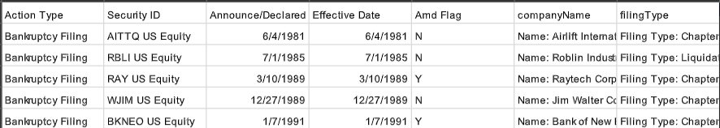
Bankruptcy Indicator - Bloomberg Data
From bankruptcy filings
Issue: Merging require first six digit of cusip but we weren’t able to obtain a security id & cusip pair data from bloomberg
Solution: Merged via company name

Slide 21
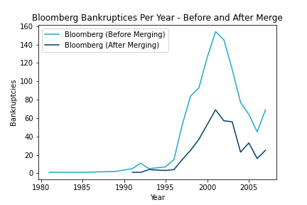
Bankruptcy Indicator - Bloomberg Data

Slide 22
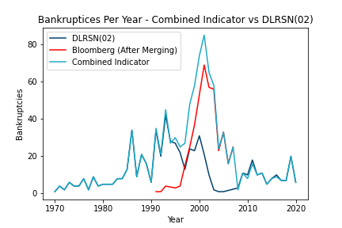
Bankruptcy Indicator - Combined Indicator

Slide 23
Bankruptcy Indicator - DLRSN
Observed Fact: DLRSN Bankruptcy Code (02) shows significantly less bankruptcies for firms then we would expect or can confirm.
Firms who were in process of going bankrupt were acquired or liquidated by larger and healthier firms
Change in acquisition or bankruptcy strategy
Reasoning
Issue
Firms that have all the characteristics of bankruptcy and would have gone bankrupt but were acquired / delisted for another reason disrupt the indicator
Possible Solution
Develop Criteria / Process for Identifying such firms and reclassifying their DLRSN code as bankruptcy (02)

Slide 24
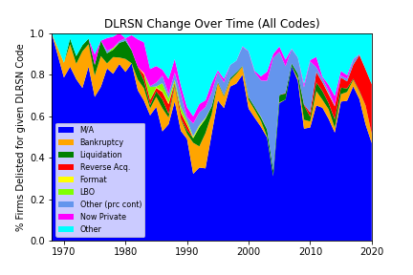
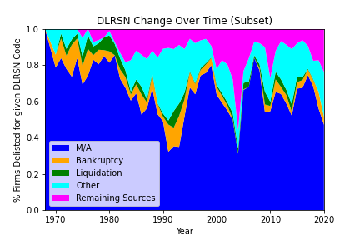
Bankruptcy Indicator - DLRSN (Closer Analysis)

Slide 25
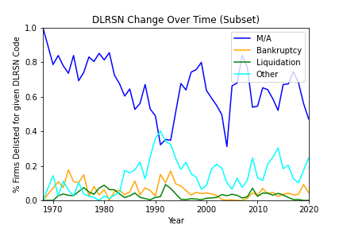
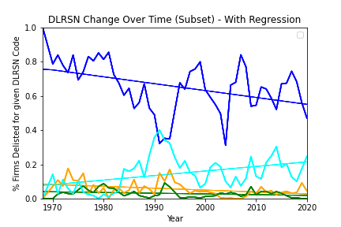
Bankruptcy Indicator - DLRSN

Slide 26
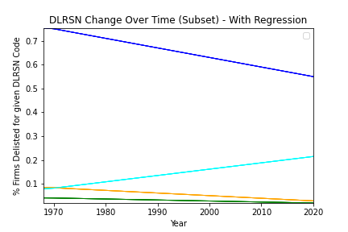
Bankruptcy Indicator - DLRSN
 | Estimate | SE | T-Stat
M/A | -0.0040 | 0.001 | -3.169
Bankruptcy | -0.0011 | 0.000 | -2.954
Liquidation | -0.0004 | 0.000 | -1.995
Other | 0.0027 | 0.001 | 3.162
Significant Change in Delisting Reason for Firms over Time

Slide 27
Future Work
Week 1
Week 2
Week 3
Week 4
Data Collection and Processing
Portfolio Analysis and ML Classification Algorithms
Finalize Data Collection and Begin Model Training (Logit)
Explore ML Classification Algorithms
Gather Data from all sources necessary, developing comprehensive universe creation rules. Deal with processing data.
Finalize Data Collection Methodology across groups and begin Model Training with Logistic Regression.
Form portfolios based on Logistic Regression Probabilities for Bankruptcies and explore ML Classification Algorithms such as Random Forest, SVG, and Neural Nets.
Finalize ML Classification Algorithms and recalculate portfolios. Compare and analyze results

Slide 28
Questions?
Please ask questions / offer any insights!

